Slide 1
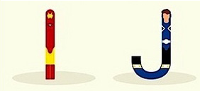
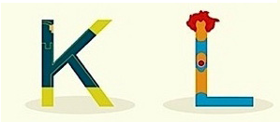
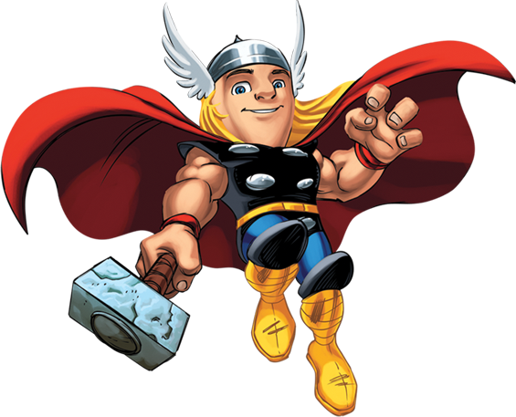
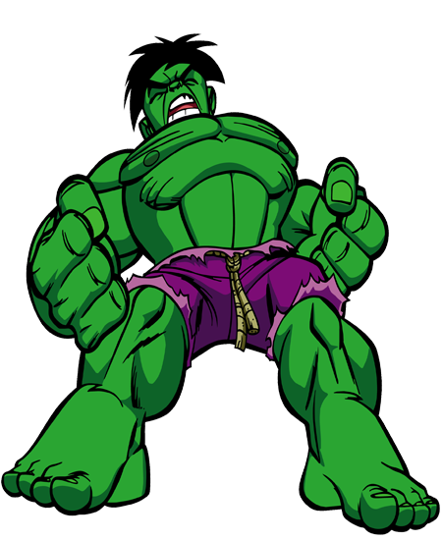
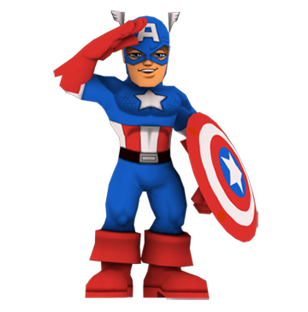
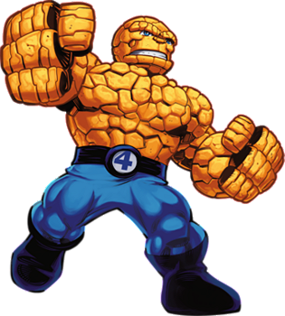
£1 £2 £3 £4 £5 £6 £7 £8 £9 £10
£11 £12 £13 £14 £15 £16 £17 £18 £19 £20
What is the value of your name?
Which superhero has the most expensive name?
Can you find a superhero worth £84.00
£21 £22 £23 £24 £25 £26

