Slide 1
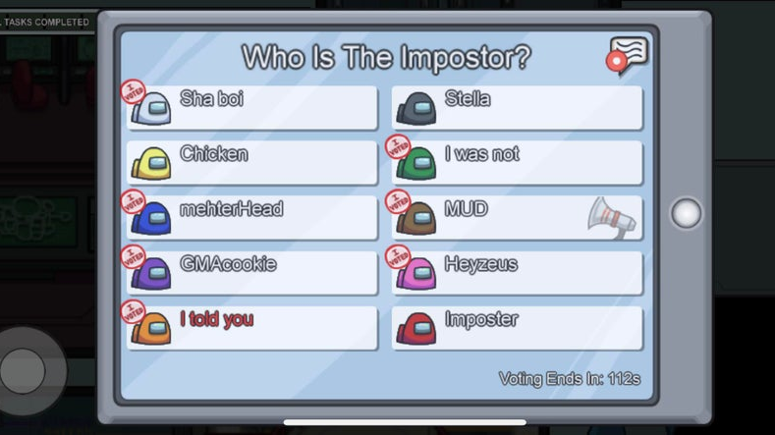
12 x 12 = 144
1234 – 321 = 913
5³ = 125
100 ÷ 5 = 20
256 ÷ 8 = 32
1234 + 5678 = 6812
6 x 6 = 36
11 x 11 = 121
126 ÷ 6 = 22
96 ÷ 6 = 16
Notes:
The imposters are:
Orange – answer is 21
Brown – answer is 6912

