Slide 2
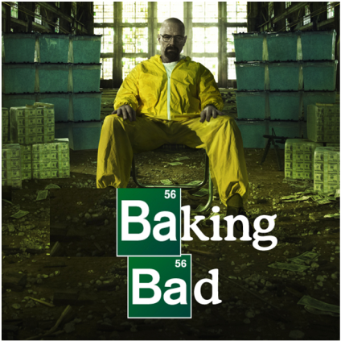
Baking Bad – Season 4
The story of a desperate Food Technology teacher…

Slide 3
The Back Story
William “Billy” Black has been a Food Technology teacher for years, won awards at local bake-offs and is well known for producing the best cakes in the local area. As a result he has been earmarked by visiting aliens to become their planet’s official chef. Billy has therefore decided to sell his wares to provide for his family when he’s gone…

Slide 4
Your help is required…
William “Billy” Black wants to see if he’s on course to hit his targets regarding the money he’s made to provide for his family once he’s gone off with the aliens.
He has a computer programme that has provided him with some data.
Can you help him interpret that data?

Slide 5
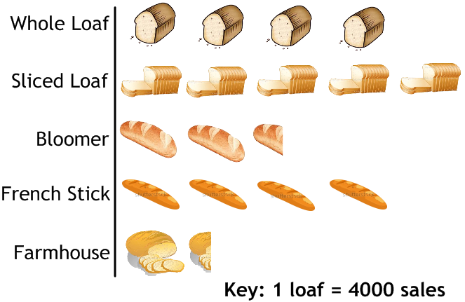
Pictogram – Bread Sales
Answers:
Sliced
10000
68000
Which is the most popular loaf?
How many Bloomers has he sold?
How many loaves has he sold in total?

Slide 6
Bar Graph – Cake Sales
Answers:
Chocolate Brownie
7000
30000
Which is the most popular type of cake?
How many flapjacks has he sold?
How many cakes has he sold in total?

Slide 7
Pie Chart – Pie Sales
Answers:
Steak and Kidney
¼
28000
Which is the most popular type of pie?
What fraction of the total sales are made up by chicken and ham pies?
If he’s sold 7000 chicken and ham pies, how many pies has Billy sold in total?

Slide 8
Bar Graph – Average Sales
Answer:
2.72
The graph shows how many cakes 50 customers each bought.
Calculate the average (mean, median and mode) and range for this data.

Slide 9
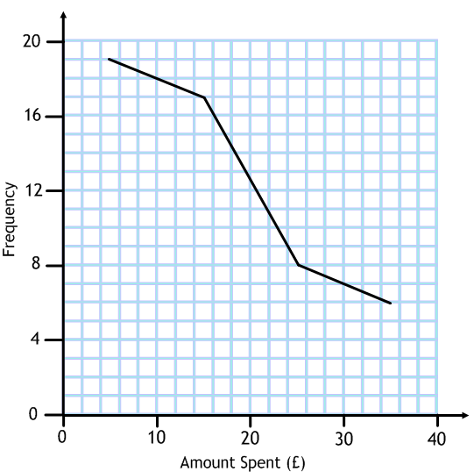
Frequency Polygon – Average Spend
Answer:
£15.20
The graph shows how much 50 customers spent in the shop in one transaction.
Estimate the average spend of each customer.

Slide 10
Thanks for all your help!

