Slide 1
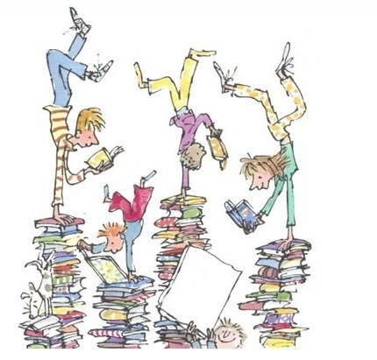
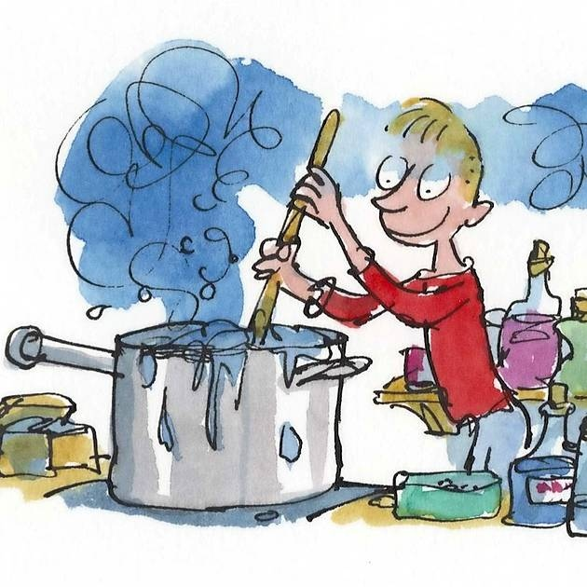
George keeps forgetting the order of his 6 medicine bottles. Use the clues to work out the order of the bottles. | The first bottle does not contain cough syrup. | The bottle next to the cough syrup is purple.
The orange bottle is in an odd numbered position. | The green bottle is made up of the colours of bottles 1 and 6. | The cough syrup is stored in a red bottle and two places up from it is the blue bottle.
Notes:
Order of George’s bottles is as follows: Blue, Purple, Red, Green, Orange and Yellow.

Slide 2
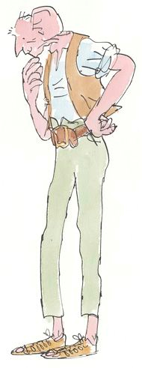
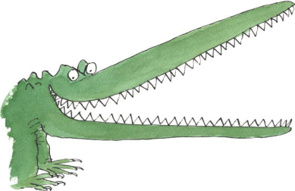
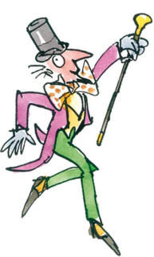
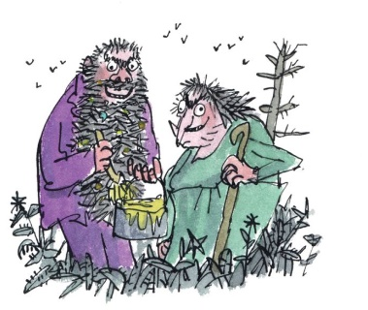
= 65
= 100
= 80
= 105
= 65
= 75
Notes:
The value of the characters is as follows: The Twits are 5, George is 25, Willy Wonka is 50, Enormous Crocodile is 10 and Matilda is 30.

Slide 3
= 65
= 100
= 80
= 105
Notes:
The value of the characters is as follows: The Twits are 5, George is 25, Willy Wonka is 50, Enormous Crocodile is 10 and Matilda is 30.

Slide 4
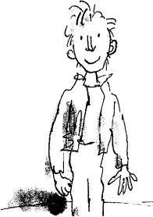
= 140
= 139
= 177
= 163
Notes:
The value of the characters is as follows: The Twits are 62, George is 13, Willy Wonka is 27, Enormous Crocodile is 74, BFG is 100, Charlie is 17 and Matilda is 3.

